Slide 1


Stay Upright.
Stay Aware.
Stay Safe At Flinders
Important advice to maintain safety and awareness

Slide 2

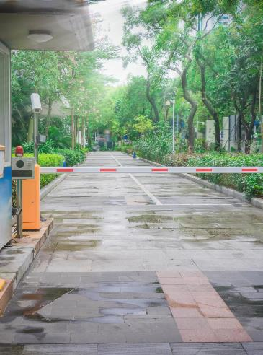
Purpose and Safety Message
Purpose
  Raise awareness of slip, trip and fall hazards and promote shared safety responsibility.
Common Hazards and Prevention
  Identify typical causes and learn simple actions to reduce incidents.
Encouraging Proactive Safety
  Focus on everyday behaviours to stay alert, report hazards, and follow safety procedures.
Campus Safety Culture
  Promote a culture where everyone contributes to safety by identifying hazards and supporting one another.

Slide 3
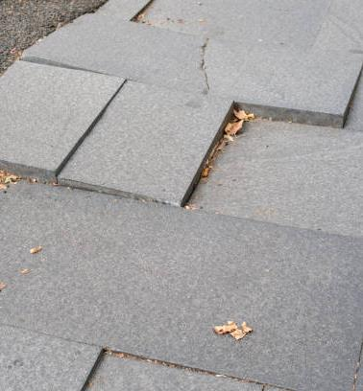
Common Slip, Trip and Fall Hazards
Wet and Slippery Surfaces
Wet floors / surfaces from rain, spills, or cleaning cause slip hazards, especially on outdoor shaded pathways and stairs.
Uneven and Damaged Flooring
Uneven surfaces, cracked pavement, and poorly maintained flooring create a significant trip risk indoors and outdoors.
Indoor Clutter and Obstacles
Cluttered walkways, cords and equipment left in corridors contribute to indoor trip hazards.
Psychosocial & Human Factors
Rushing from one meeting to the next, carrying too many objects whilst navigating stairs and looking at mobile phones while walking all heighten the risk of a slip, trip or fall.

Slide 4

Slip, Trip and Fall
Impact of Slip, Trip, Fall Injuries
  Injuries range from minor bruises to serious fractures and long-term damage, impacting health and wellbeing.
Prevention and Safety Culture
  Proactive hazard management and awareness fosters safer environments and reduce incidents

Slide 5
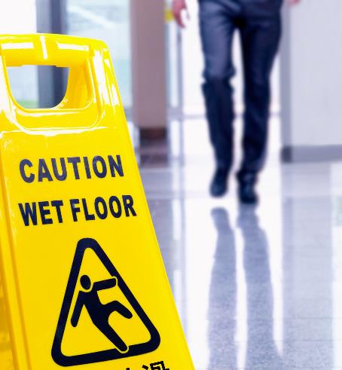
Preventing Slips, Trips and Falls
Environmental Controls
Immediate cleanup of spills and use of clear wet floor signage reduce slip hazards effectively.
Appropriate Footwear
Wearing shoes with good grip and slip-resistant soles.
Safe Behaviour
Slowing down, avoiding use of phone while walking, and when carrying items maintain visibility or use other methods to transport items.
Maintain Clear Walkways
Keep walkways free of obstacles like boxes and equipment to prevent trip hazards.

Slide 6
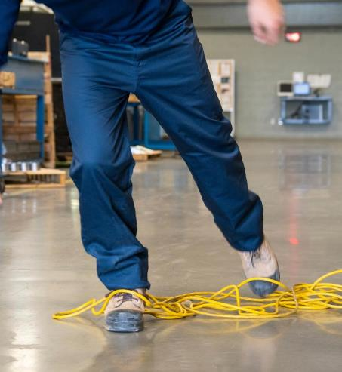
Preventing Slips, Trips and Falls
Secure Electrical Cords
Cover or secure electrical cords and cables to avoid trips, especially in offices and labs.
Report Damaged Flooring
Promptly report damaged flooring, loose tiles, and worn stair edges for timely repair.
Practice Behavioural Awareness
Avoid rushing, maintain focus, minimise distractions, and use handrails on stairs and ramps.

Slide 7
Psychosocial Risk Factors and Controls
Psychosocial Risk Factors
Busy workload or back-to-back meetings cause people to rush, increasing the risk of a slip, trip or fall.
Plan Meeting Schedules
Consider travel time when planning meetings, either plan the meeting to finish earlier than scheduled or allow more time for travel.
Block out time in your calendar to prevent others scheduling back-to-back meetings.
Practice Behavioural Awareness
Look before you move, avoid distractions, walk at a slower pace, use a trolley rather than carrying items are actions that all assist in preventing a slip, trip or fall.

Slide 8
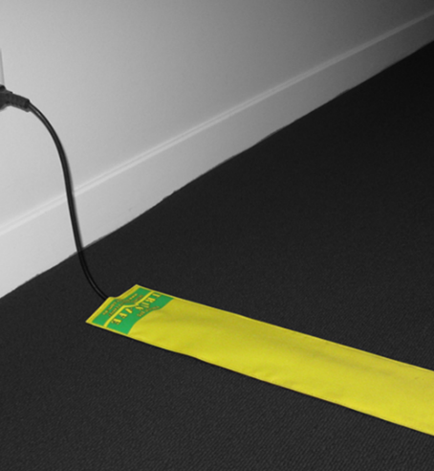
Shared Responsibility
Individual Responsibility
Everyone must stay alert and aware, recognise hazards, and adjust behaviour to prevent incidents.
Reporting Hazards
Promptly reporting hazards and near misses helps address risks before injuries occur.
Following Safety Procedures
Adhering to safety signs and instructions ensures consistent risk management across the campus.
University Safety Culture
Looking out for others by warning or assisting fosters a positive and safer environment.

Slide 9
To Stay Upright, we all need to
Stay Aware of your surroundings, report hazards when you see them, and
By doing this, we can all Stay Safe At Flinders
Take Home Message

