Slide 1
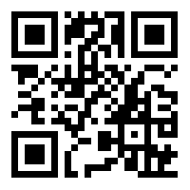
Emergency Contacts
FIRE, POLICE OR AMBULANCE
Internal- 0 000 External- 000
Security
Internal- 12880 External- 8201 2880
Reminder: If calling for Fire, Police or Ambulance attendance please also call security who will provide
an escort.
Health, Counselling and Disability Service
(Level 3, Student Services Centre next to the Sports Centre)
Internal- 12118 External- 8201 2118
ChemWatch
(For Safety Data Sheets)
Three ways to access:
24/7 Emergency phone number 1800 039 008
Goto URL: https://goo.gl/XsV5hv
Scan the QR Code:

